Slide 1

MOOC (Massive Open Online Course):
The New Way of Learning

Slide 2

INDONESIAX
IndonesiaX is an e-learning platform, reminiscent of edX, a university-level Massive Open Online Course (MOOC) platform that was spearheaded by the Massachusetts Institute of Technology (MIT) and Harvard University in 2012
Anybody, anywhere in Indonesia and/or abroad at any time convenient to him or her can learn from the best instructors from the best universities and companies in Indonesia and/or abroad for free to increase their knowledge and life skills, just by a touch of a button

Slide 3
VISION AND MISSION
VISION
To be the most preferred independent online MOOC/SPOC hosting platform which enriches lives of Indonesians.
MISSION
To provide a state-of-the-art, sustainable, and affordable online MOOC/SPOC hosting platform that offers free high quality online MOOCs/SPOCs provided by the best local and foreign universities, government agencies, companies and other respected institutions.
To help democratize education and improve life-skills of Indonesians spread out in Indonesian archipelago.

Slide 4
WHY MOOC FOR INDONESIA
Challenge
Oppotunities
Need for economic growth
Need to create job opportunities (entrepreneurs)
Need to be globally competitive (competition from neighboring countries)
Limited access to high education and training in general (spread out in 17,000 islands and 34 provinces)
Quantity and quality of human capital
Teacher training (school, TVET and higher education)
Skills/competency and aptitude
Rapid changes in ITE
Indonesia is one of the countries with highest internet users (1Q17 Kominfo: 262 million population, 132 million internet users, 371 million cellular phone users)
Demographic bonus in 2025 to 2035 (number of people within the productive age bracket is higher than the number of elderly people and children)

Slide 5
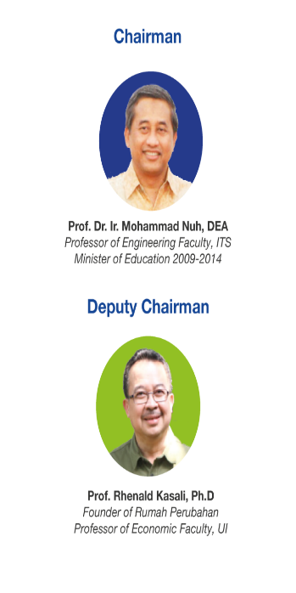
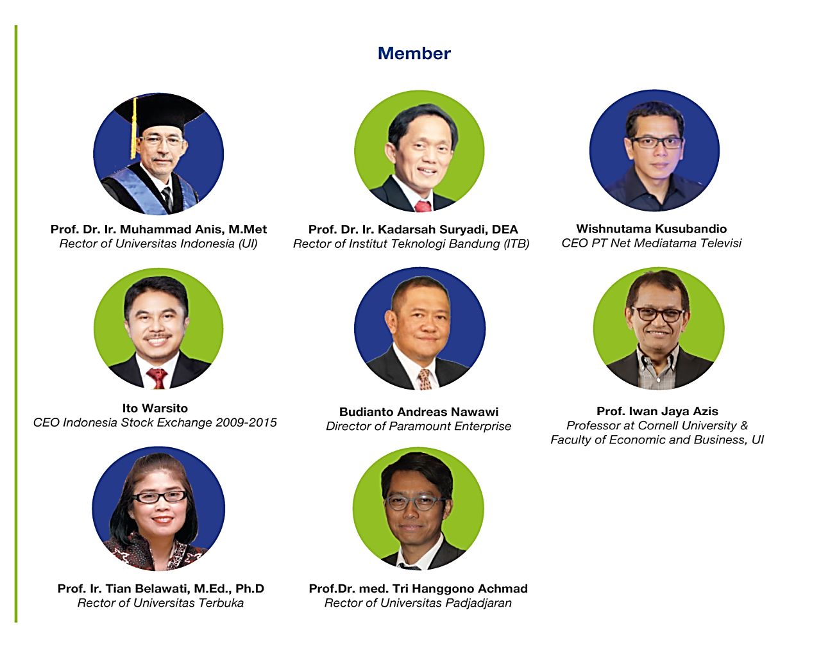
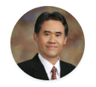
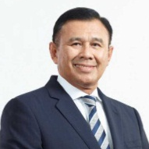
OUR ADVISORY COUNCIL
Prof. Ir. Panut Mulyono, M.Eng., D.Eng.
Rector of Universitas Gajah Mada
Prof. Ir. Panut Mulyono, M.Eng., D.Eng.
Rector of Universitas Gajah Mada (UGM)
Achmad Baiquni
President Director of PT. Bank Negara Indonesia (Persero) Tbk.

Slide 6
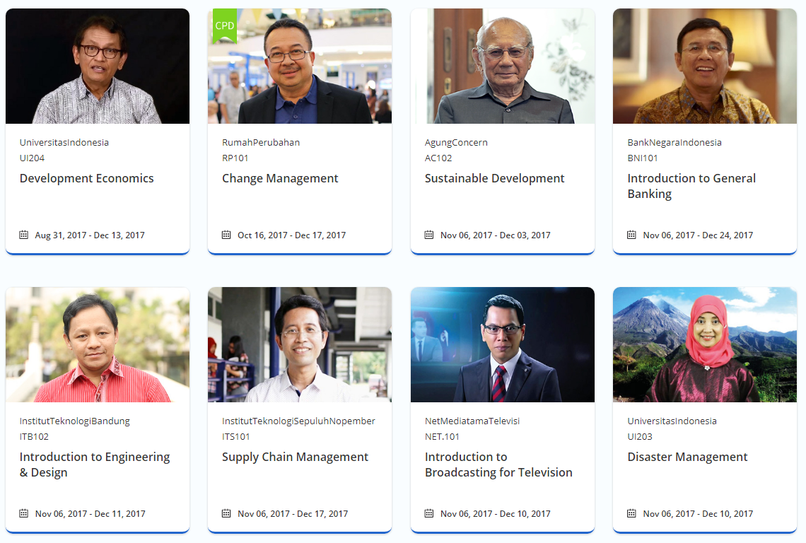
OUR COURSES
We aim for 30% Academic and 70% Life Skills

Slide 7
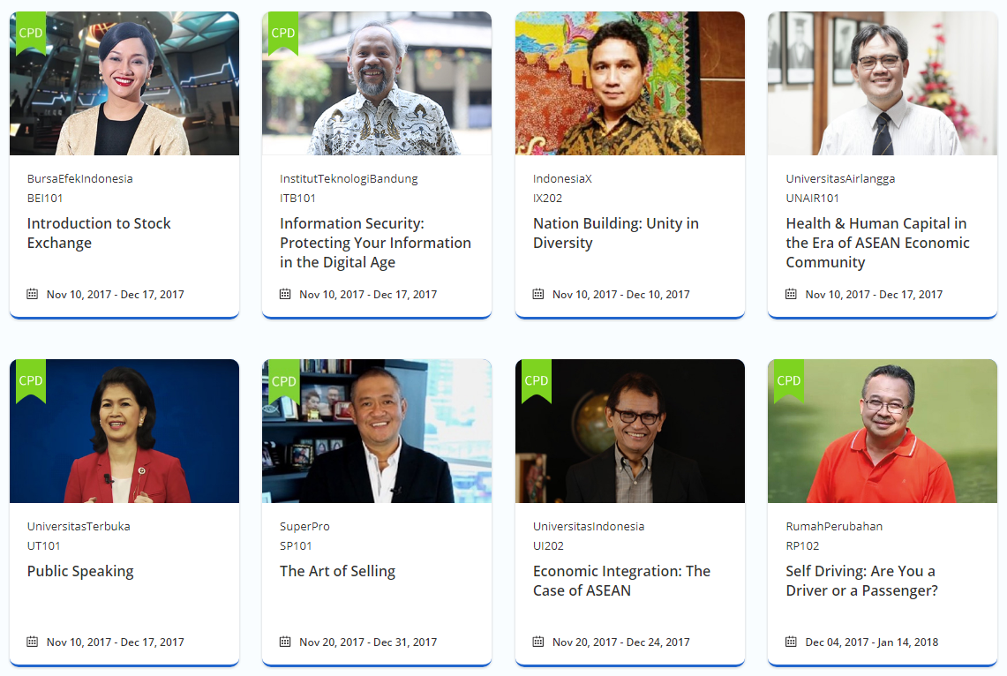
OUR COURSES
We aim for 30% Academic and 70% Life Skills

Slide 8
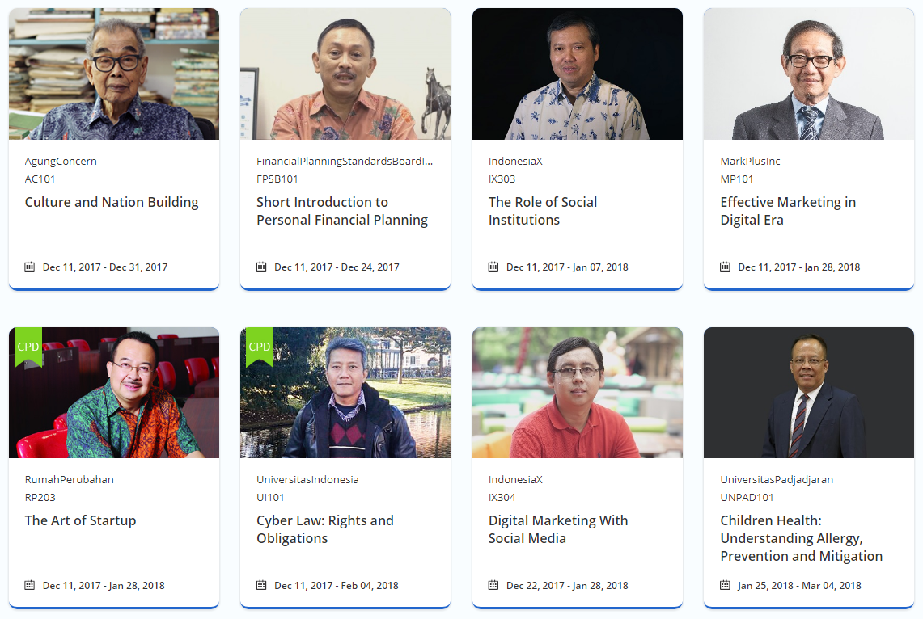
OUR COURSES
We aim for 30% Academic and 70% Life Skills

Slide 9
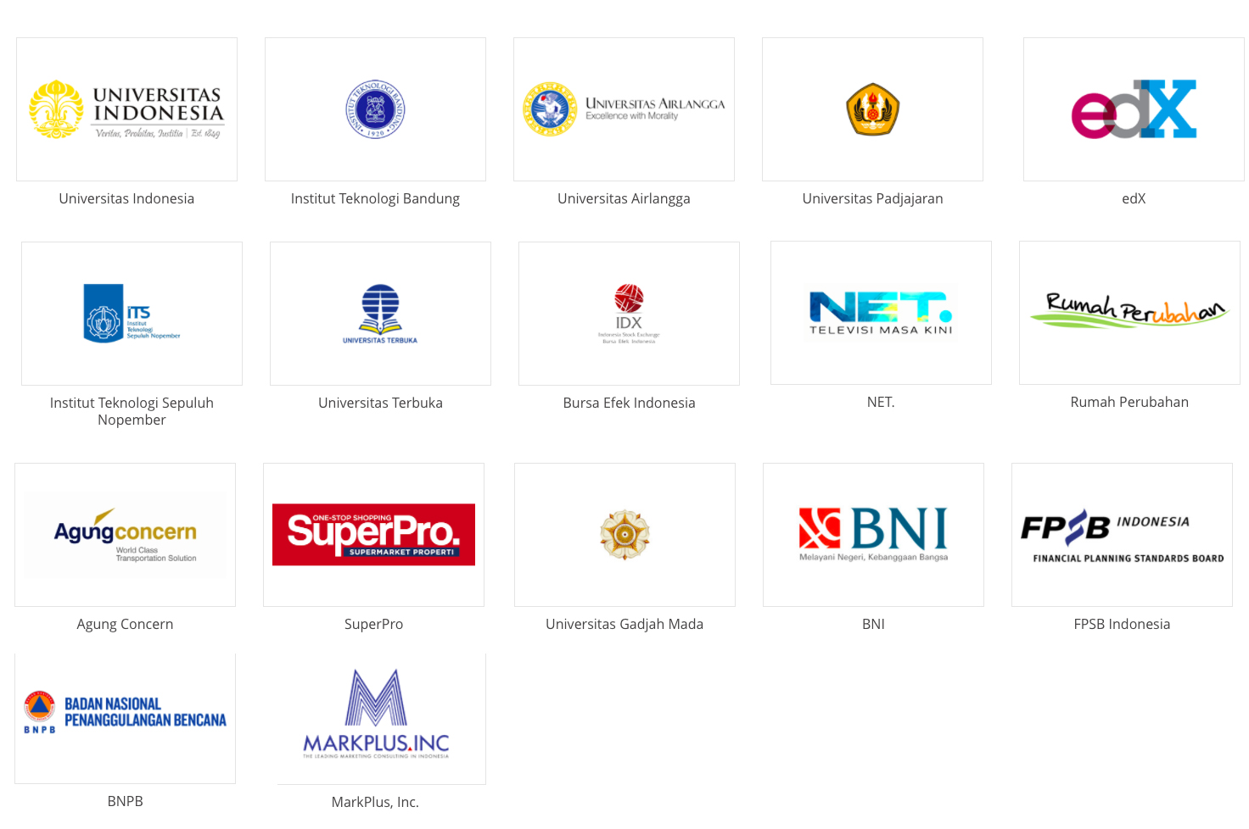
OUR PARTNERS

Slide 10
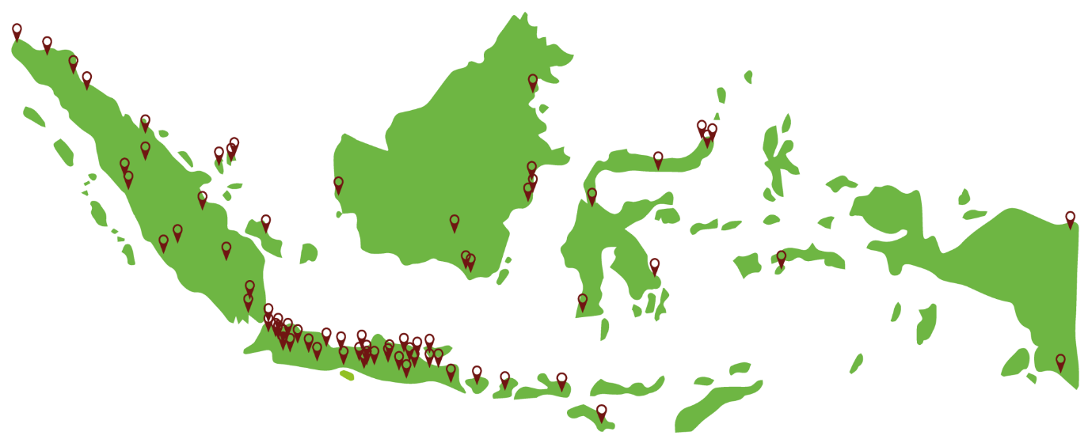
WHERE WE
ARE NOW
as per Dec 4, 2017
Top 5 Provinces
1. West Java 22,08%
2. DKI Jakarta 16,7%
3. East Java 13,9%
4. Banten 7,04%
5. Central Java 6,7%
Learners from Java 51,11%
Learners from other 48,89%
provinces in Indonesia

Slide 11
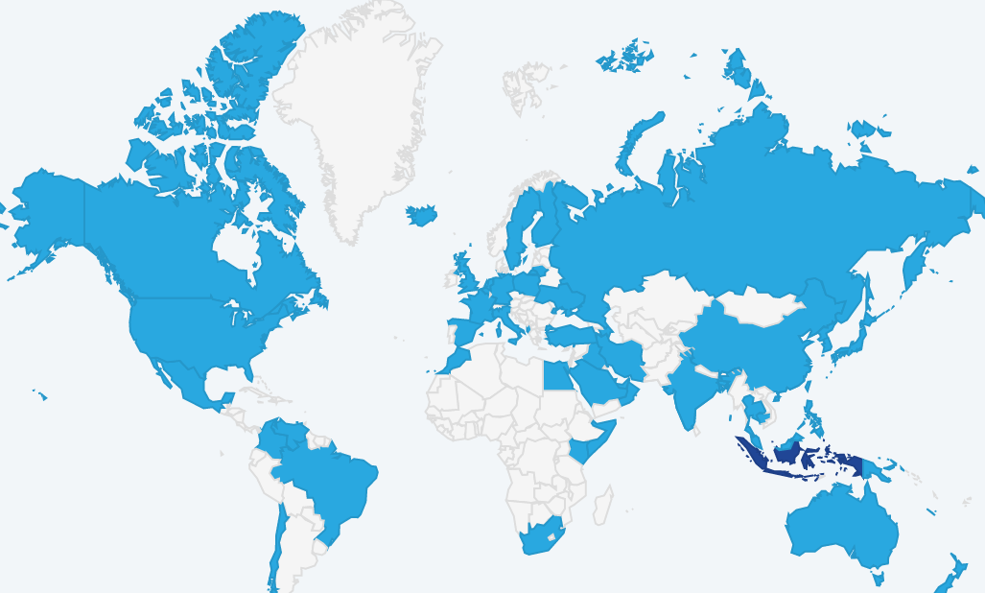
GLOBAL REACH
as per Dec 4, 2017
# Countries
83
# Course Registrants
135.116
# GlobalCities
224
# of Page Views
6.216.825
Notes:
5342895

Slide 12
OUR LEARNERS
as per Dec 4, 2017

Slide 13
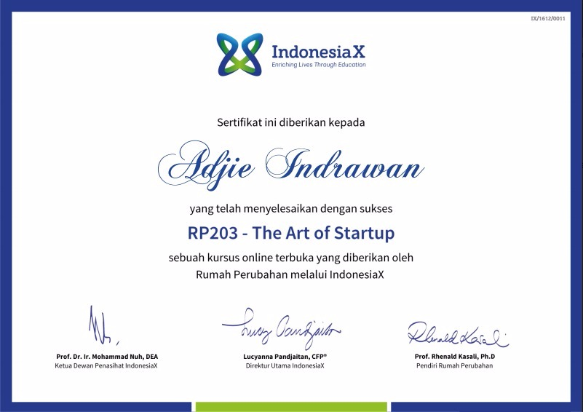
OUR CERTIFICATE

Slide 14
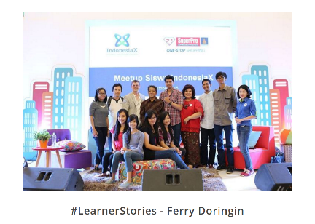
LESSONS LEARNED
Positive response from students
Positive response from universities
(both on MOOC existence as well
as in providing content)
Positive response from corporates (in providing content and in using the courses as training material)
Positive responses from government officials and institutions
Poor internet connection in provinces in East Indonesia and in some West too
Difficulty in getting funding

Slide 15
GOING FORWARD
Reach more cities/towns in Indonesia
Cooperation with telco companies and broadcast media to reach wider area coverage
Involvement of ministries (such as Ministry of Telecommunication & Information, Barekraf, Ministry of Disadvantaged Regions, Ministry, Ministry of Manpower, Ministry of Higher Education, Research & Technology) in reaching learners
Collaboration with Industry Association (including APOI, ADEI) and NGOs
More MOOCS from companies/industries (HC requirement)
Training platform for corporates and financial institutions
Curriculum Development
More MOOCs from foreign universities on latest development
English translation
Accreditation
Sustainability (business model)

Slide 16
Why you
should be a partner of IndonesiaX
CSR
you help democratizing education, reducing disparity in education levels and thus improving life-skills of Indonesians spread out in Indonesian archipelago.
you help young people lacking access to quality education and knowledge in acquiring the competence needed to face the demographic bonus era and thus help optimization of the dividend from the era.
Promotion
your logo will be displayed on IndonesiaX homepage with hyperlink to you website.
Demonstration of competence of your top management by providing Massive Open Online Course in IndonesiaX.co.id with topic (s) relevant to the industry or good governance.

Slide 17
THANK YOU
Please check us out
at www.indonesiax.co.id

Slide 18
ATTACHMENTS

Slide 19

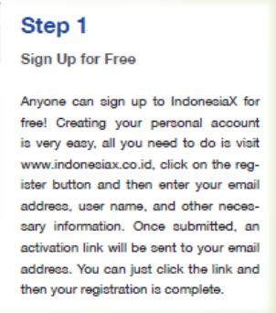
HOW TO REGISTER

Slide 20
HOW TO REGISTER

Slide 21
HOW TO REGISTER

Slide 22
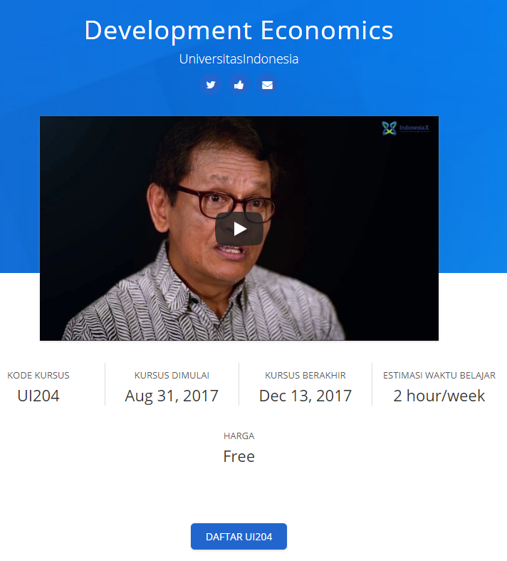
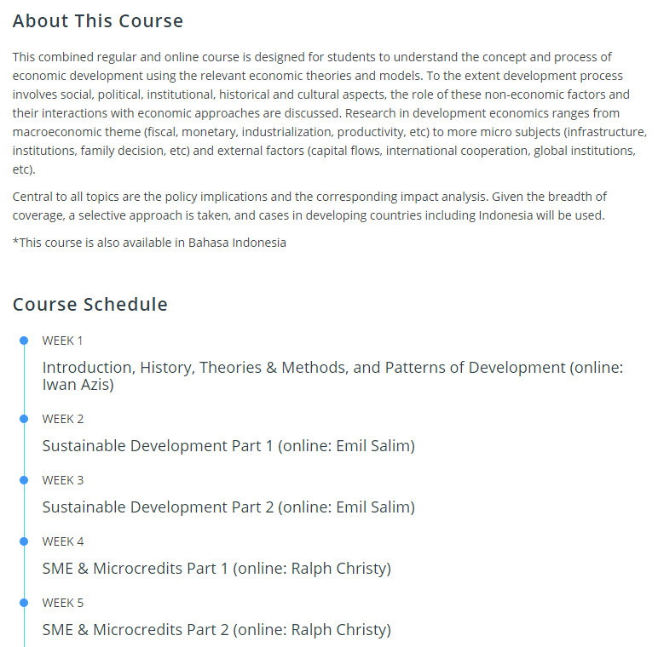
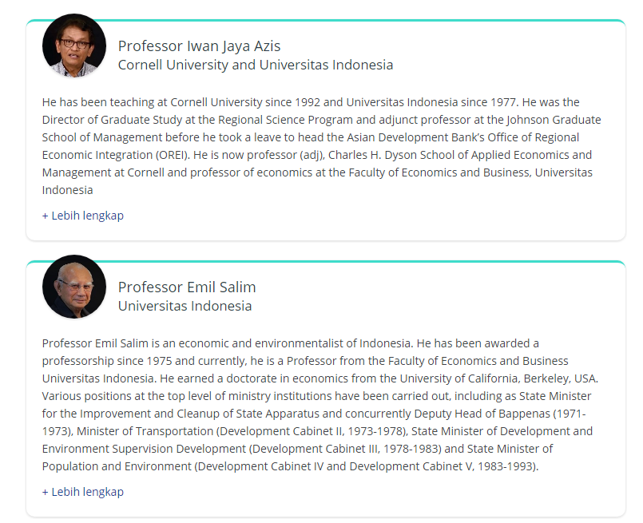
LEARNING MANAGEMENT SYSTEM

Slide 23
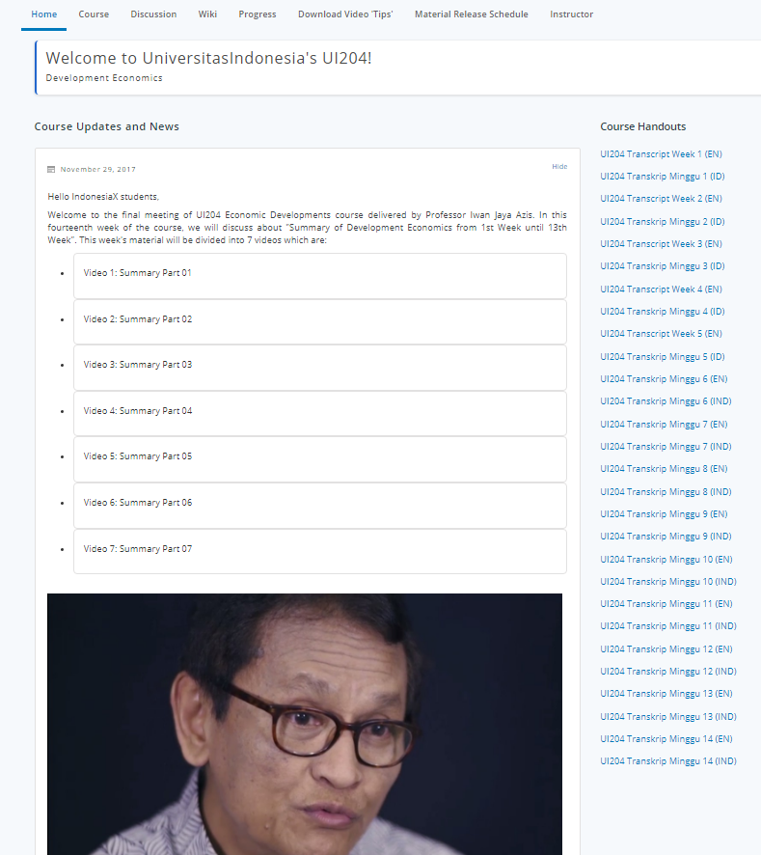
LEARNING MANAGEMENT SYSTEM

Slide 24
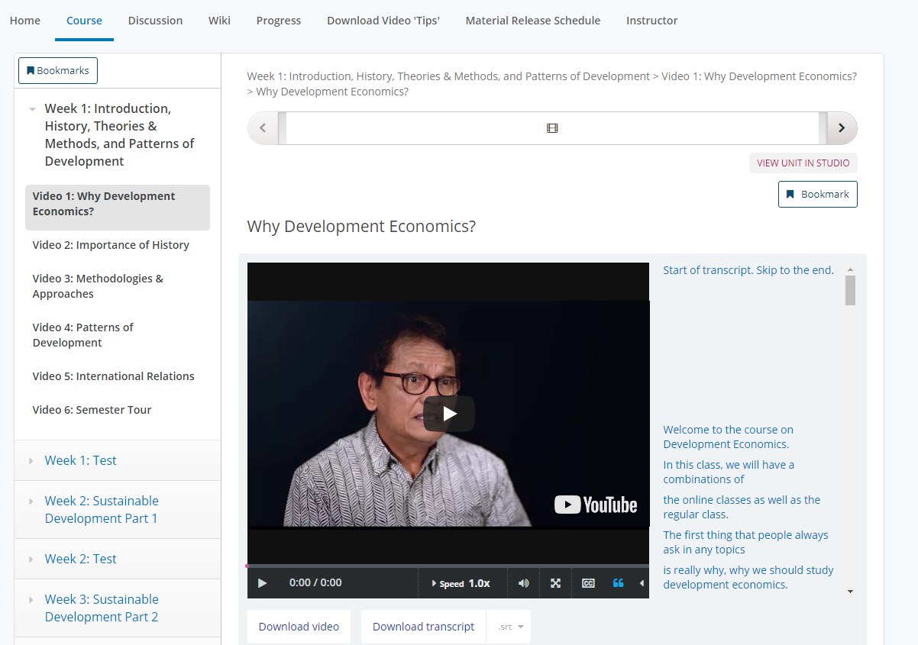
LEARNING MANAGEMENT SYSTEM

Slide 25
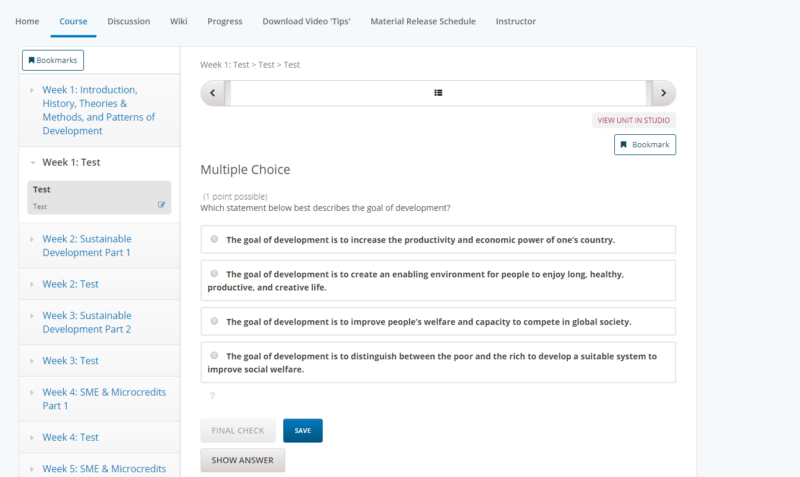
LEARNING MANAGEMENT SYSTEM

Slide 26
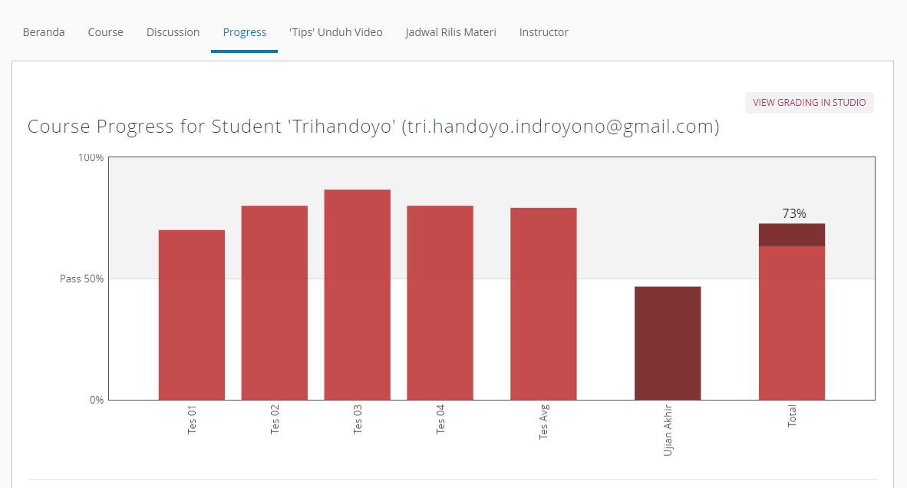
LEARNING MANAGEMENT SYSTEM

Slide 27
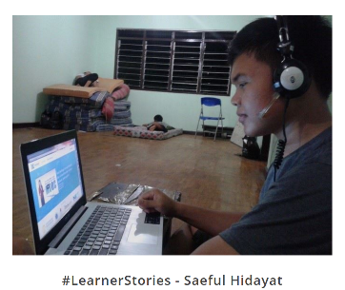
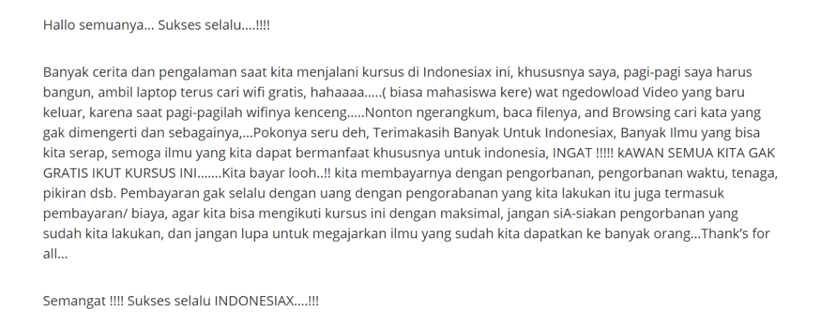
LEARNERS’ STORIES

Slide 28
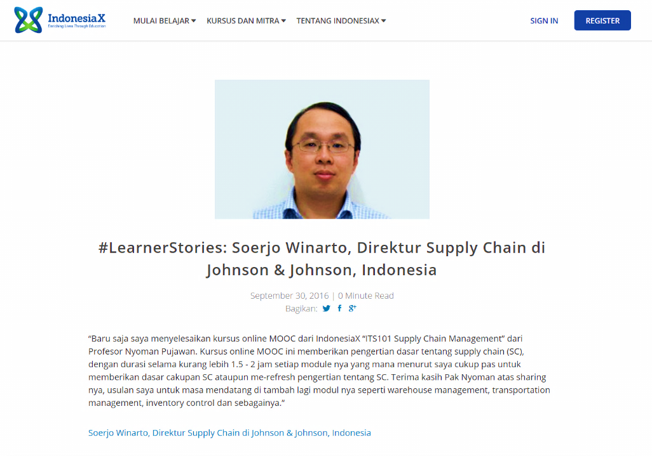
LEARNERS’ STORIES

Slide 29

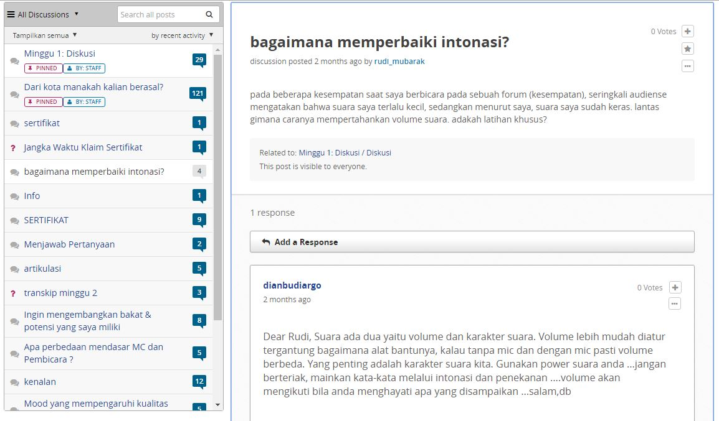
GET MORE ENGAGED WITH PARTNERS AND LEARNERS
(1) Discussion Forums

Slide 30
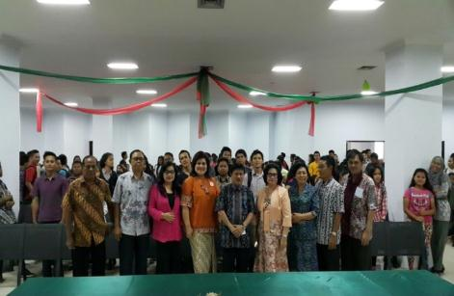
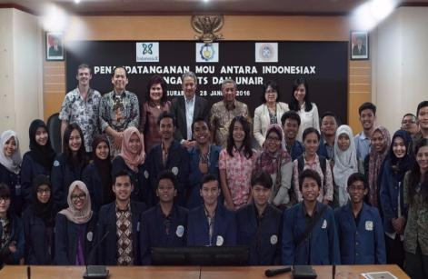
GET MORE ENGAGED WITH PARTNERS AND LEARNERS
(2) Meet Ups
Tondano,
19-11-15
Surabaya,
28 -01-16

Slide 31
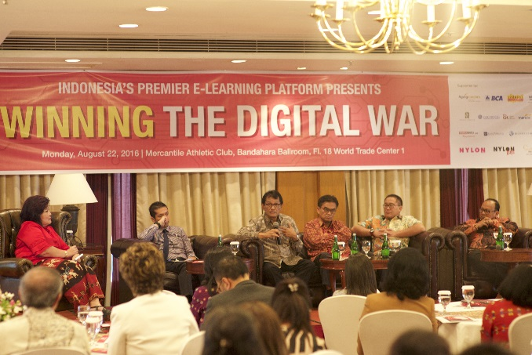
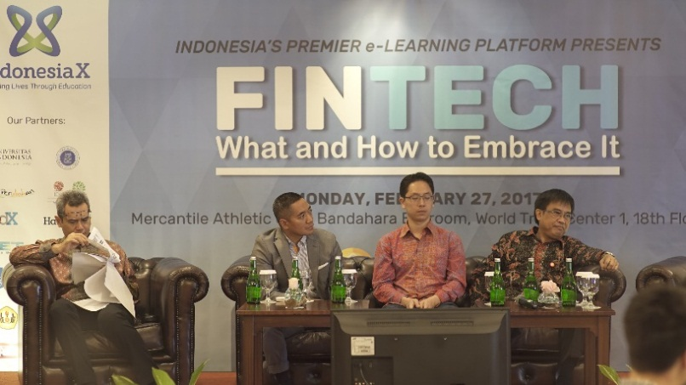
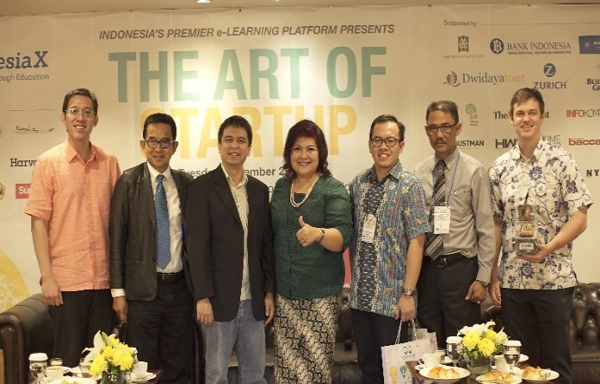
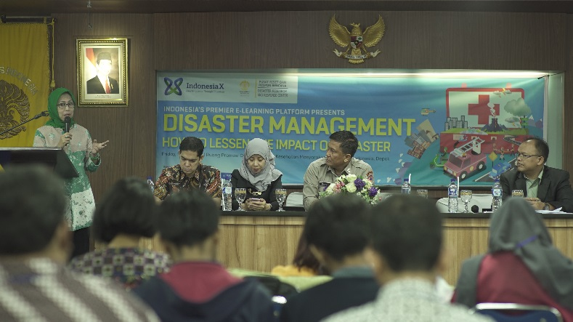
GET MORE ENGAGED WITH PARTNERS AND LEARNERS
(3)Quarterly Conferences
Jakarta,
22-08-16
Jakarta,
27-02-17
Jakarta,
29-11-16
Depok,
05-05-17

Slide 32





OUR QUARTERLY CONFERENCES : Starting on our first anniversary
(Aug 2016)

Slide 33

6th INDONESIAX CONFERENCE : DEC 4TH, 2017

Slide 34
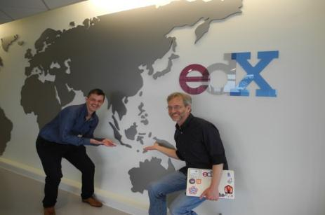
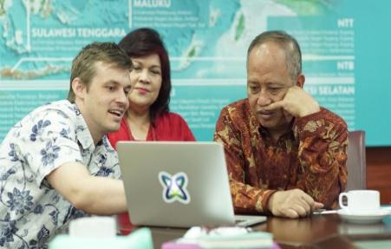
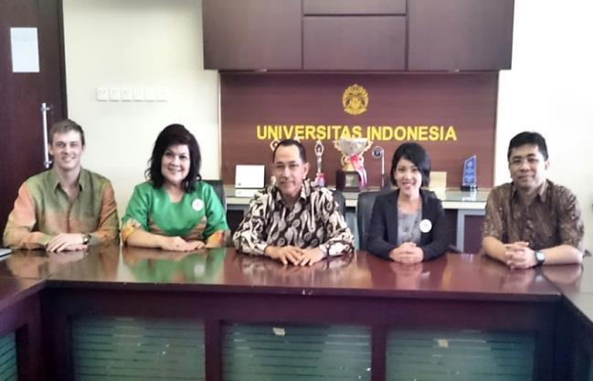
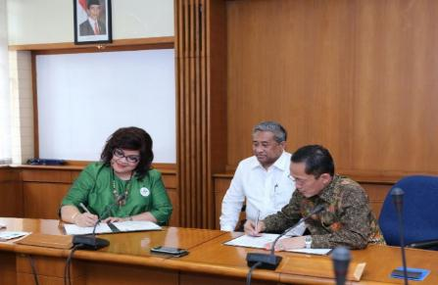
HOW WE EVOLVE
With the Minister of Research, Technology and Higher Education Indonesia, Mr. Muhammad Nasir
Visit to edX
With Minister Muhammad Nasir
Meeting with University
of Indonesia
MoU Signing ceremony with ITB

Slide 35
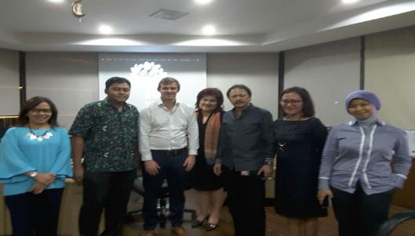
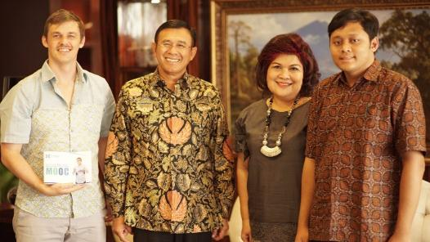
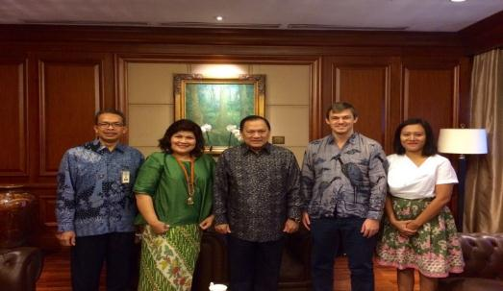
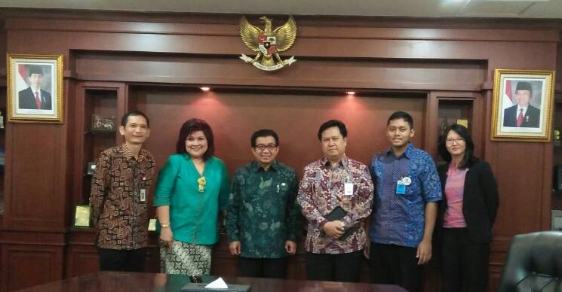
HOW WE EVOLVE
With the President Director of Indonesia Stock Exchange, Mr. Tito S
With the President Director of BNI,
Mr. Achmad Baiquni
With Governor of Bank Indonesia, Mr. Agus D.W. Martowardojo
With the Chairman of Indonesia Financial Services Authority , Mr. Muliaman Hadad

Slide 36
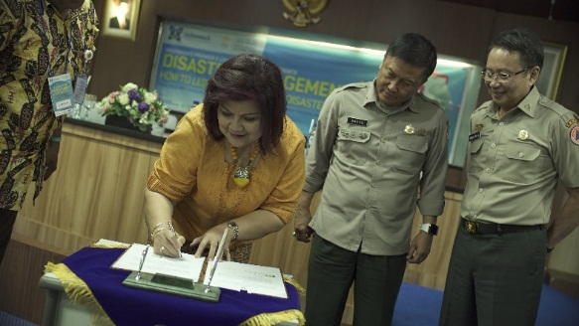
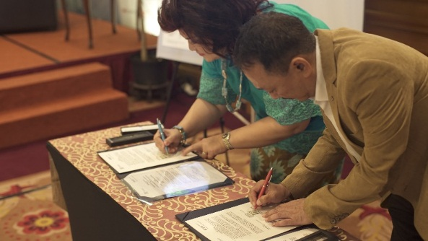
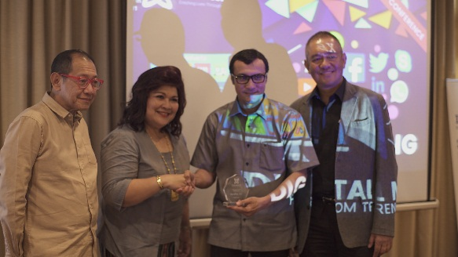
HOW WE EVOLVE
MOU Signing ceremony with Badan Nasional Penanggulangan Bencana (BNPB)
MOU Signing ceremony with
FPSB Indonesia
With founder Markplus. Inc, Mr. Hermawan Kartajaya

